Slide 1
Using NLP techniques for answering questions about COVID-19 using Kaggle Dataset
Authors: Abel González, André Novaes, Gustavo Coelho and Lucas Pavanelli
INF2420-2020.1

Slide 2
OUTLINE
Introduction.
Scope.
Method.
Result & discussion.
Final remarks.

Slide 3
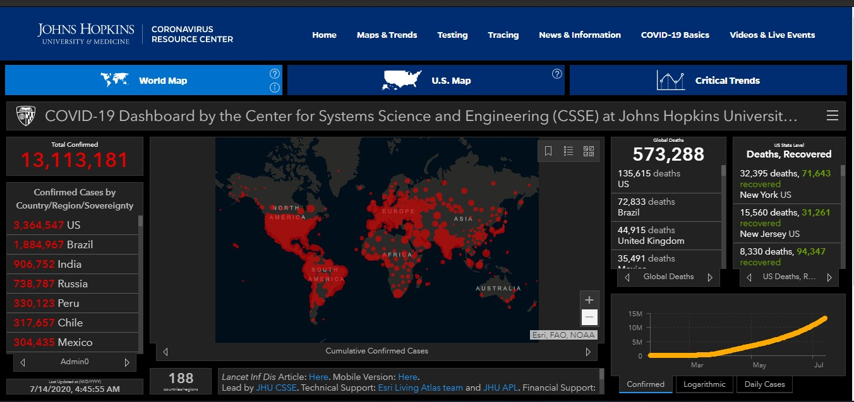
Source: https://coronavirus.jhu.edu/map.html 14/07/2020 04:45 a.m.

Slide 4
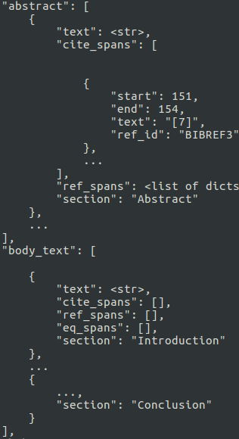
INTRODUCTION AND SCOPE
COVID-19 Open Research Dataset
~13 GB
Over 135,000 scholarly articles
Including over 68,000 with full text
First goal: What do we know about COVID-19 symptoms?
Second goal: How can we cluster papers into coherent groups?

Slide 5
FIRST GOAL: WORDS REPRESENTATION
Chosen method: GloVe – Global Vectors for word representation
Generate Corpus using the provided dataset
Create word vectors
Measure cosine distance

Slide 6
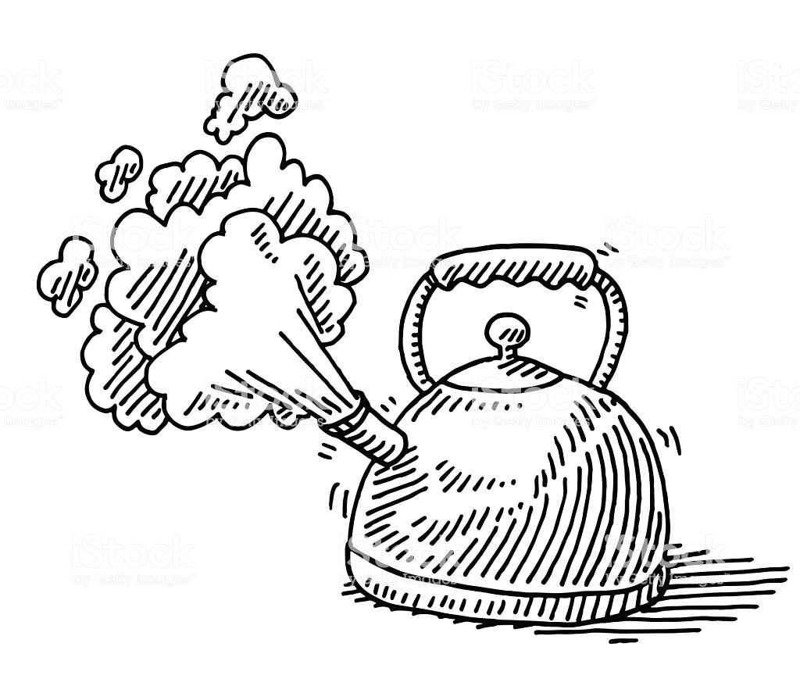
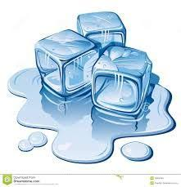

GLOVE
Begin with a example showcasing how certain aspects of meaning can be extracted directly from co-occurrence probabilities.
P (word j appear in the context of word i) = P (j/i)
P ( / )
P ( / )

Slide 7
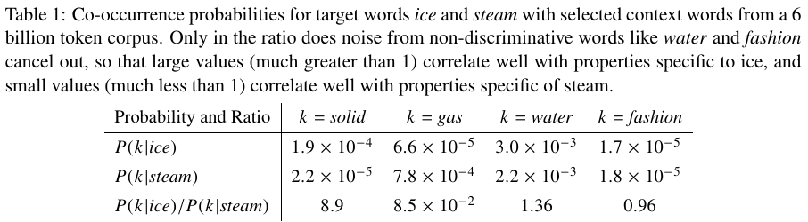
GLOVE
The above argument suggests that the appropriate starting point for word vector learning should be with ratios of co-occurrence probabilities rather than the probabilities themselves.

Slide 8
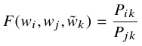
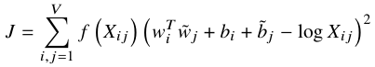
GLOVE
w are word vectors; the RHS is extracted from the corpus; F is not unique.
Pennington et al. (2014) propose a new weighted least squares regression model that addresses previous problems, casting the previous equation as a least squares and introducing a weighting function f () into the cost function.

Slide 9
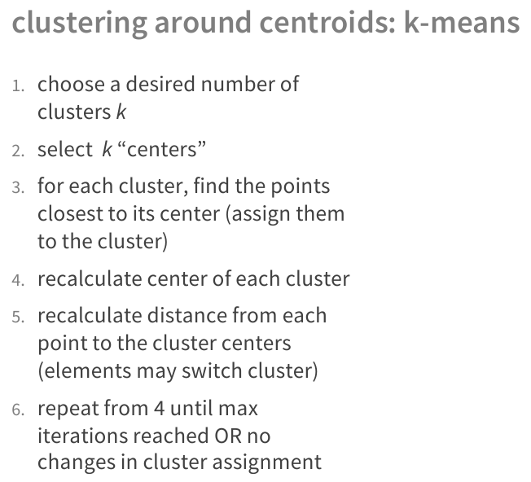
With Word Vectors: K-Means

Slide 10
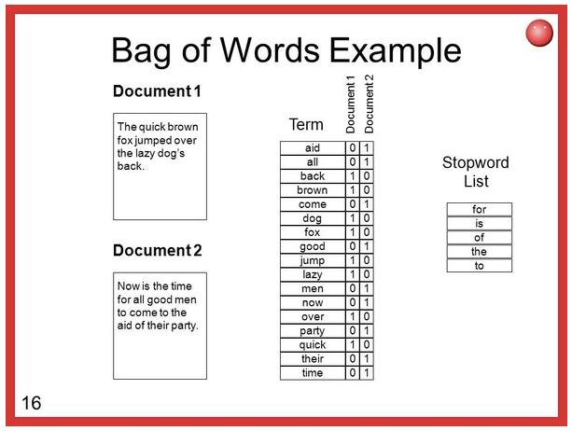
Bag of Words

Slide 11
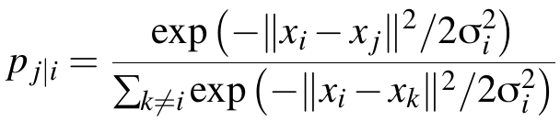
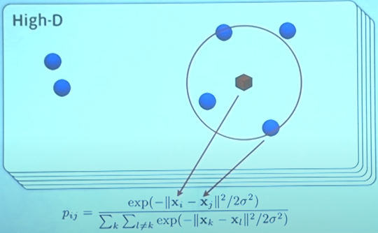
SNE (Stochastic Neighbor Embedding)
Credit to Laurens van der Maaten (https://www.youtube.com/watch?v=EMD106bB2vY)

Slide 12
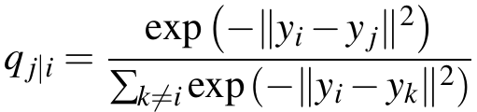
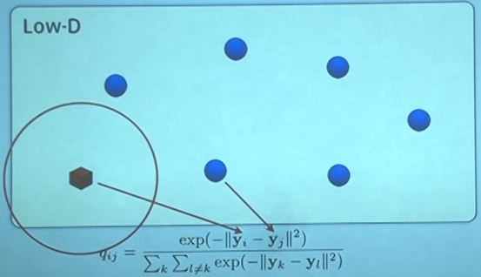
SNE

Slide 13
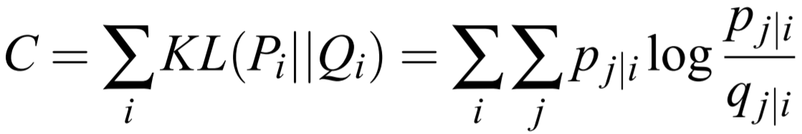
SNE
Objective: Minimize the Kullback–Leibler (KL) divergence function, by Gradient Descent, i.e., search for Yi and Yj that minimize Qj|i, in the lowest dimension.
Minimize KL because if 2 distributions have KL = 0 then the 2 distributions are the same (and vice-versa).
SNE mainly preserves local similarity data structure.

Slide 14
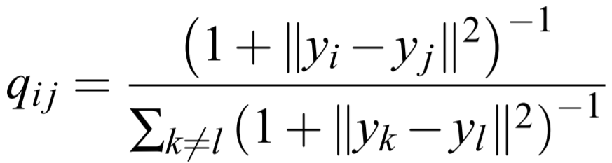
SNE
t-SNE
Credit to Laurens van der Maaten (https://www.youtube.com/watch?v=EMD106bB2vY)

Slide 15
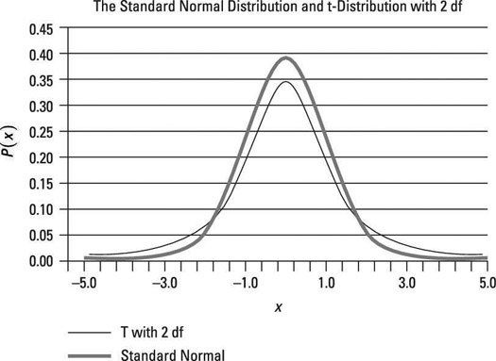
t-SNE
Credit to: https://www.dummies.com/education/math/business-statistics/how-the-number-of-degrees-of-freedom-affect-the-graph-of-a-t-distribution/

Slide 16
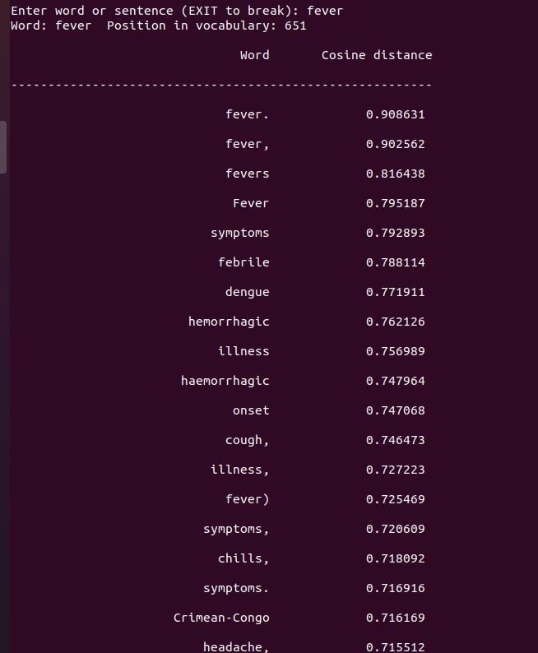
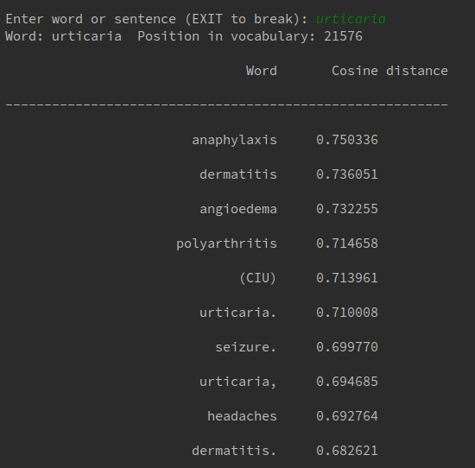
WORDS REPRESENTATION
First results:
Repeated words with capital letter
Unnecessary punctuations
Important words with low-ranking
Missing two-words expressions

Slide 17
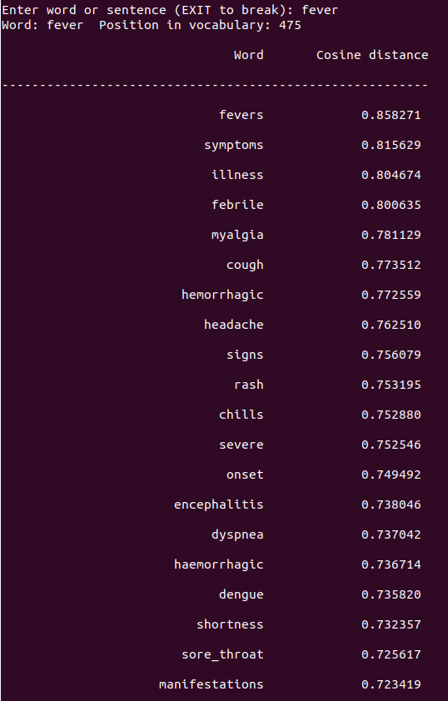
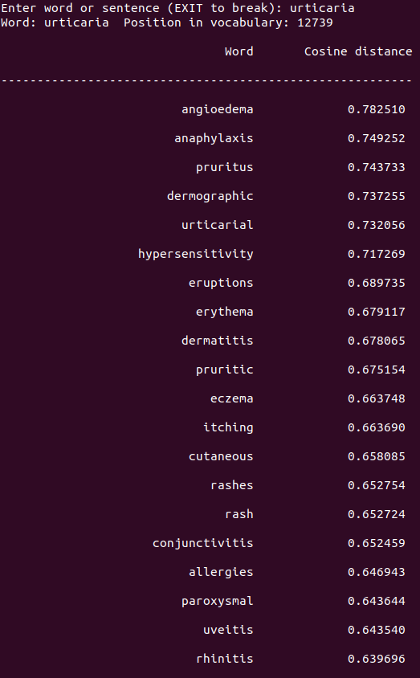
WORDS REPRESENTATION
Modifications:
Results:
- Replace every uppercase letter with lowercase one
- Remove punctuations
- Replace space with underscore in symptoms with more than one word

Slide 18
WORDS CLUSTERING
Main idea: Cluster words represented by their vectors
Remove words:
with frequency less than 50
that are only numbers
Use k-means algorithm
For each cluster get top 20 words based on their word count to represent the cluster

Slide 19
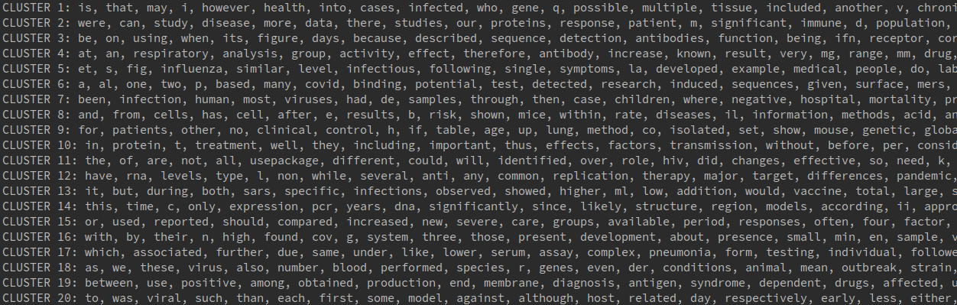
WORDS CLUSTERING
First test: using clean dataset and 20 clusters
Cannot distinguish
between clusters...

Slide 20
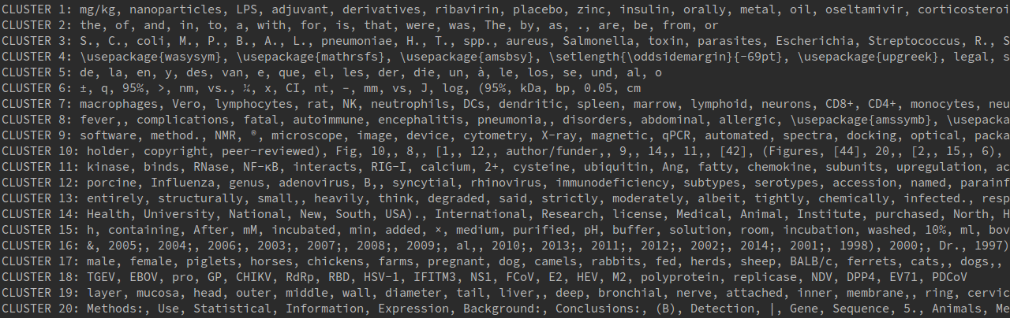
WORDS CLUSTERING
Second test: using raw dataset and 20 clusters

Slide 21
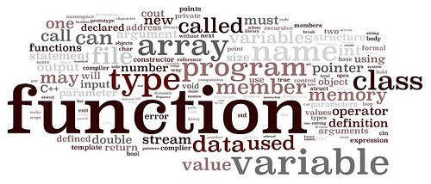
WORDS CLOUD
Clean dataset, but not removing all punctuations
Only selecting vectors:
More than 2 characters
English words
Nouns
Non numbers
Got 5000 most frequent words after vector selection
Apply TSNE with 2 components
Use kmeans with 70 clusters

Slide 22
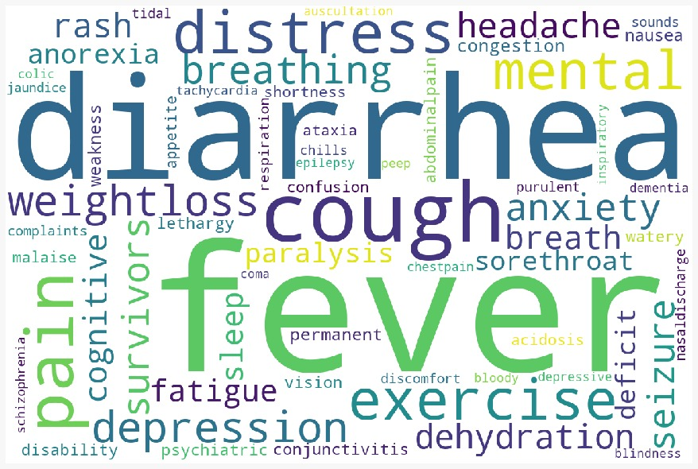
WORDS CLOUD
Symptoms:

Slide 23
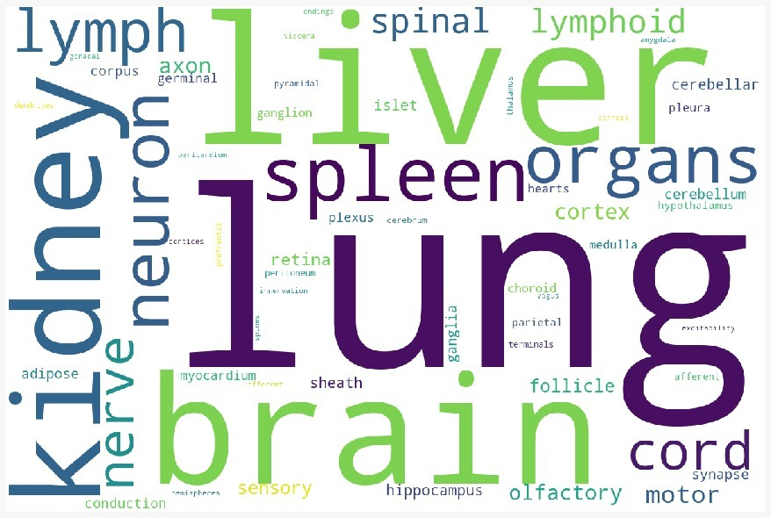
WORDS CLOUD
Organs:

Slide 24
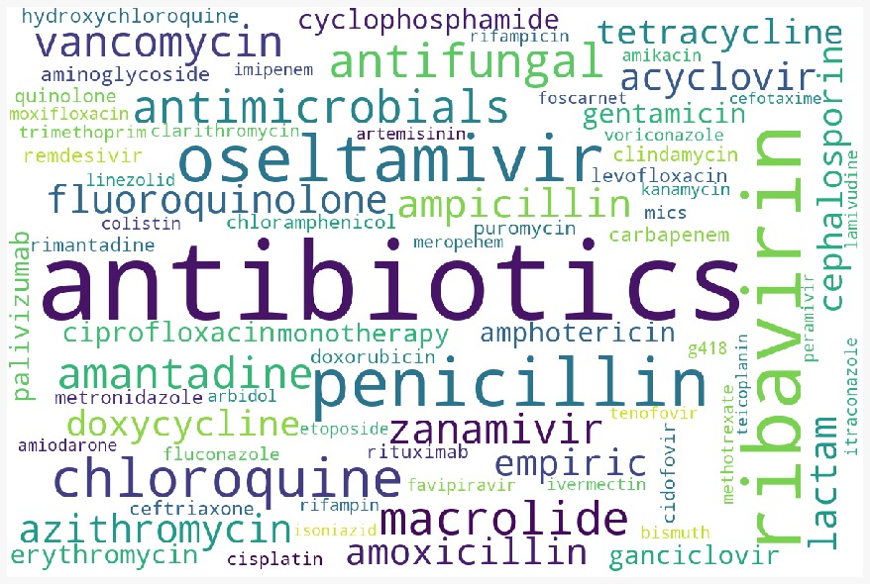
WORDS CLOUD
Medications:

Slide 25
SECOND GOAL: DOCUMENT REPRESENTATION
Chosen method: BOW - Bag of words
Create features vector for each paper using BOW model
Cluster vectors into coherent groups
Visualize clusters in a 2D plot

Slide 26
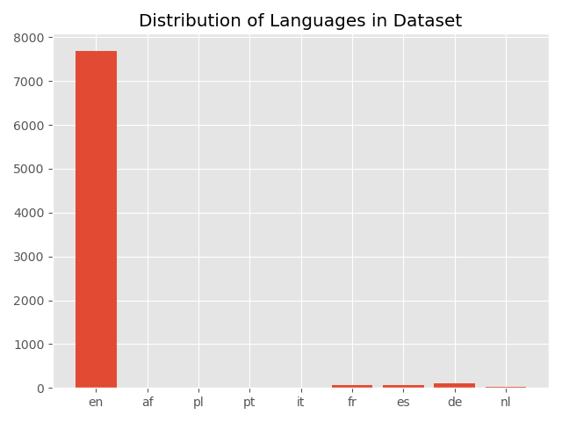
DATASET PRE-PROCESSING
Use paper’s body text
Total of 8k papers
Only get papers in english
Lemmatize words
Remove stopwords, including research specific stopwords such as 'doi', 'preprint', 'copyright', 'peer', 'reviewed', 'org'
Notes:
Using t-SNE we can reduce our high dimensional features vector to 2 dimensions. By using the 2 dimensions as x,y coordinates, the body_text can be plotted.
t-SNE did a good job at reducing the dimensionality, but now we need some labels. Let's use the clusters found by k-means as labels. This will help visually separate different concentrations of topics.

Slide 27
DOCUMENT REPRESENTATION
Use TfidfVectorizer to transform a text into a vector with 4096 dimensions
Reduce the dimensions while still keeping 95% variance by applying PCA. The reason is that this will remove some noise/outliers from the data and make the clustering problem easier for k-means
Use elbow method to determine the number of clusters for kmeans
Run kmeans with 20 clusters
Notes:
Using t-SNE we can reduce our high dimensional features vector to 2 dimensions. By using the 2 dimensions as x,y coordinates, the body_text can be plotted.
t-SNE did a good job at reducing the dimensionality, but now we need some labels. Let's use the clusters found by k-means as labels. This will help visually separate different concentrations of topics.

Slide 28
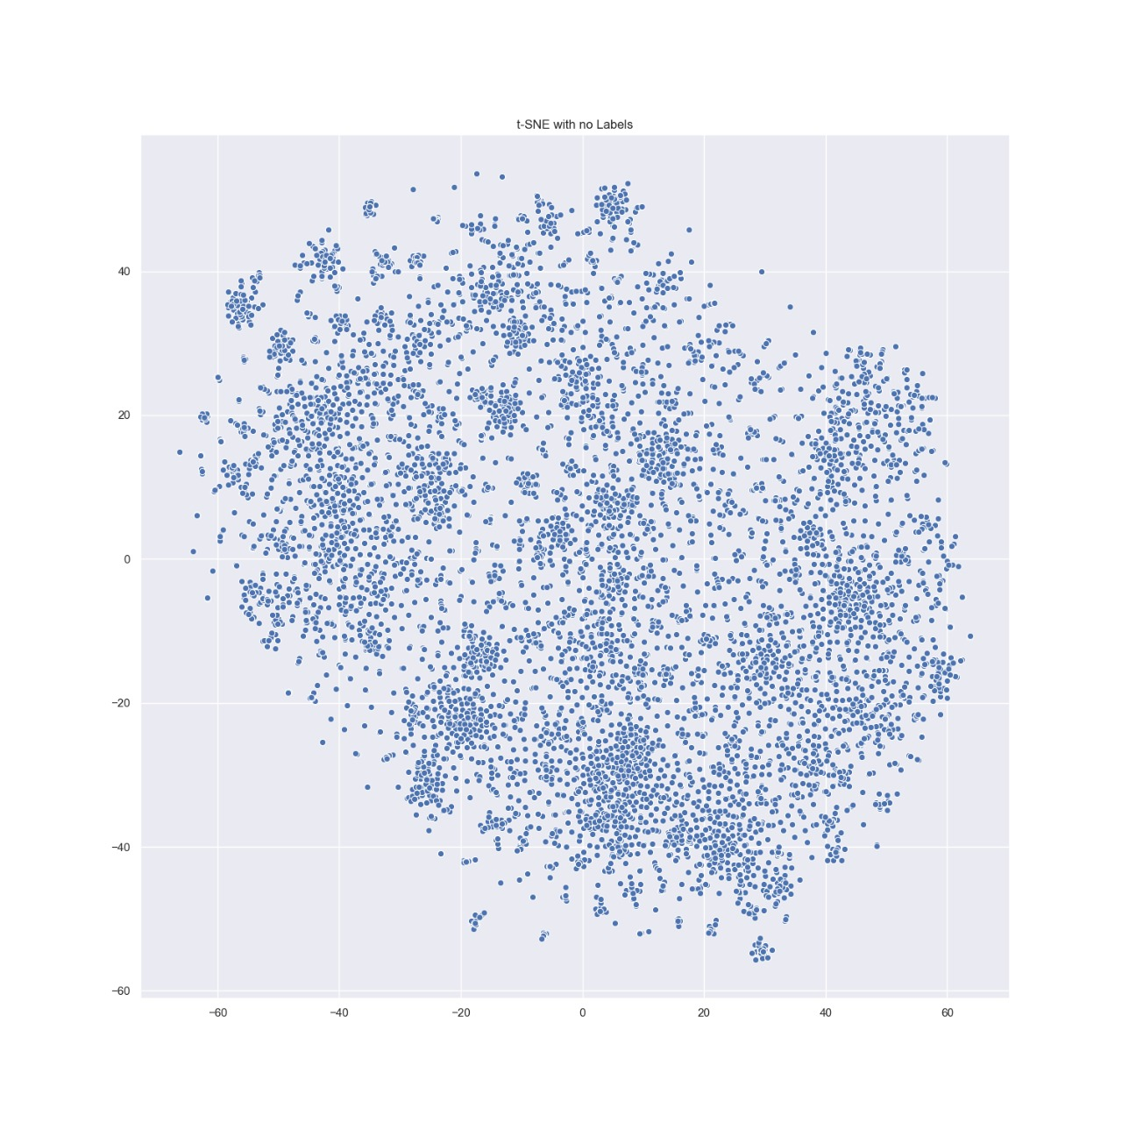
T-SNE
Using t-SNE we can reduce our high dimensional features vector to 2 dimensions
There are some clusters we can immediately detect, but the many instances closer to the center are harder to separate
Notes:
Using t-SNE we can reduce our high dimensional features vector to 2 dimensions. By using the 2 dimensions as x,y coordinates, the body_text can be plotted.
t-SNE did a good job at reducing the dimensionality, but now we need some labels. Let's use the clusters found by k-means as labels. This will help visually separate different concentrations of topics.

Slide 29
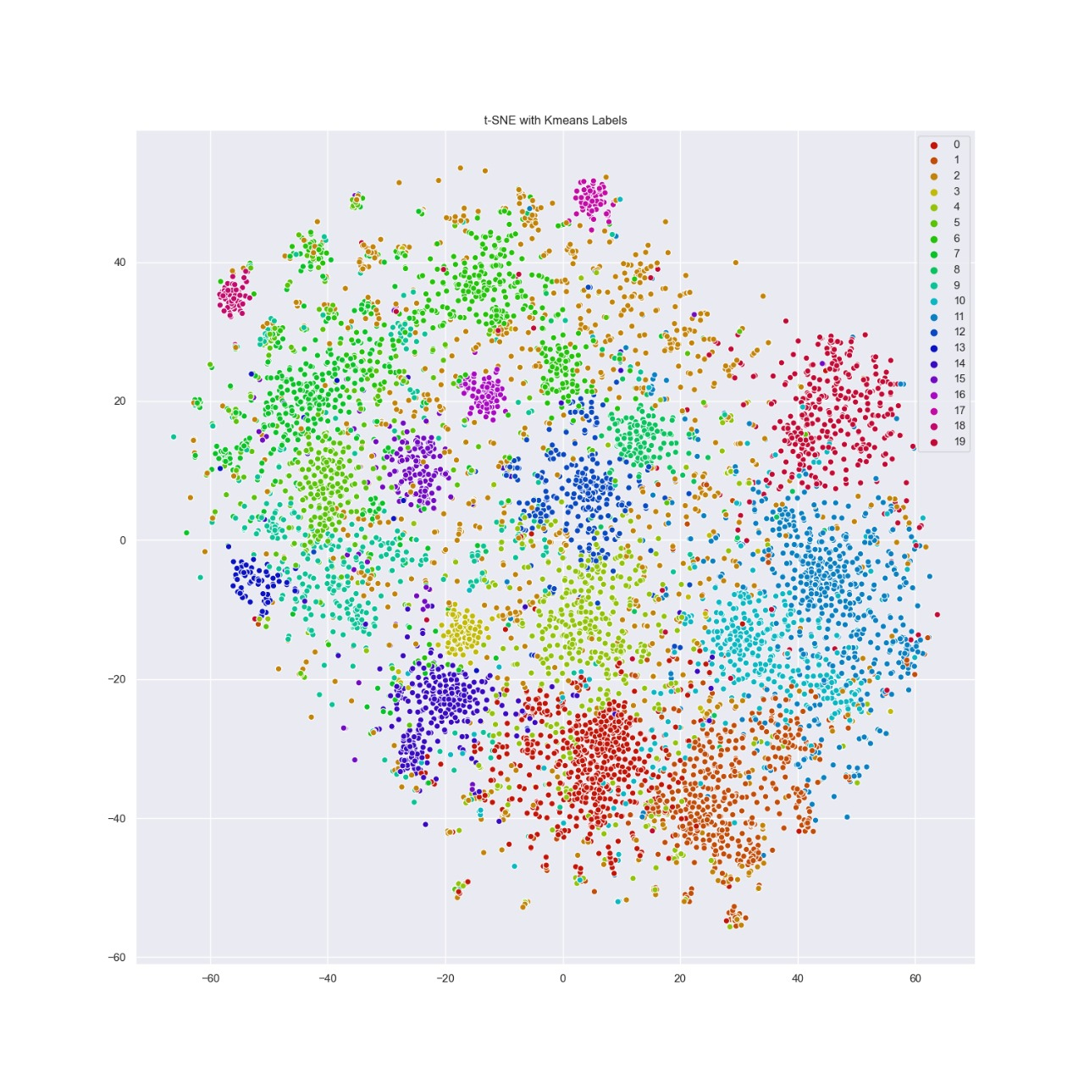
T-SNE
The labeled plot gives better insight into how the papers are grouped
There are cases where the colored labels (k-means) are spread out on the plot (t-SNE). The topics of these papers often intersect so it hard to cleanly separate them
Notes:
The labeled plot gives better insight into how the papers are grouped. It is interesting that both k-means and t-SNE are able to agree on certain clusters even though they were ran independetly. The location of each paper on the plot was determined by t-SNE while the label (color) was determined by k-means. If we look at a particular part of the plot where t-SNE has grouped many articles forming a cluster, it is likely that k-means is uniform in the labeling of this cluster (most of the cluster is the same color). This behavior shows that structure within the literature can be observed and measured to some extent.
Now there are other cases where the colored labels (k-means) are spread out on the plot (t-SNE). This is a result of t-SNE and k-means finding different connections in the higher dimensional data. The topics of these papers often intersect so it hard to cleanly separate them. This effect can be observed in the formation of subclusters on the plot. These subclusters are a conglomeration of different k-means labels but may share some connection determined by t-SNE.
This organization of the data does not act as a simple search engine. The clustering + dimensionality reduction is performed on the mathematical similarities of the publications. As an unsupervised approach, the algorithms may even find connections that were unnaparent to humans. This may highlight hidden shared information and advance further research.

Slide 30
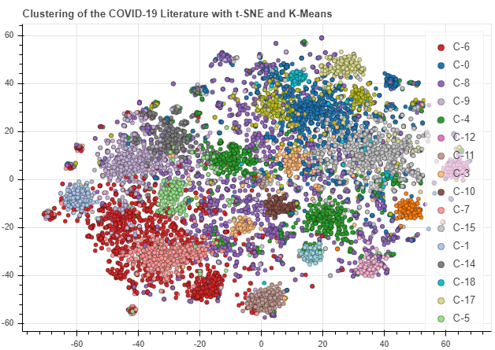
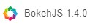
INTERACTIVE PLOT
Load the Keywords per Cluster
Setup
Widgets
Style
SHOW

Slide 31
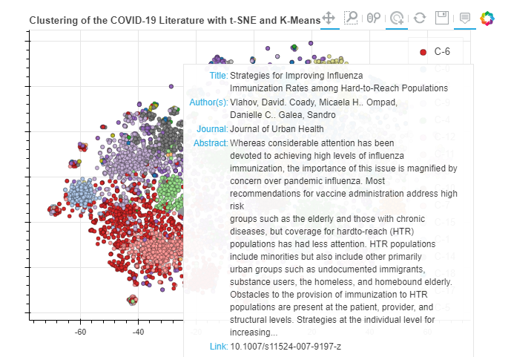
INTERACTIVE PLOT

Slide 32
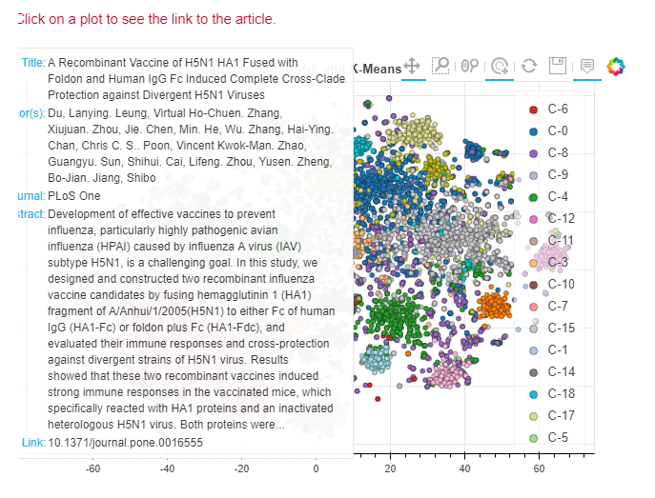
INTERACTIVE PLOT

Slide 33
FUTURE WORK
About first goal:
Identify cluster with symptoms and break it into subclusters
About second goal:
Apply some topic modeling technique, such as LDA, to get each cluster latent topic
Try to use a more complex document representation, using only paper’s abstract, because of slower run time

Slide 34
THANK YOU

